Slide 1
Successful Learners

Slide 2
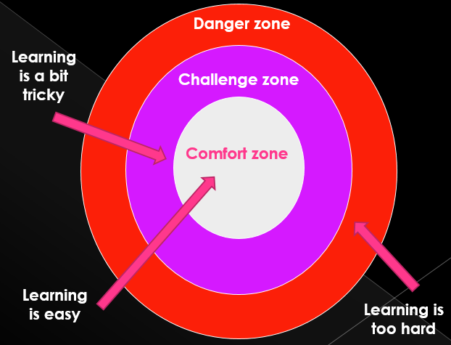
The beginning…
What is a purple learner?
helpful talk
movers
unhelpful talk
blockers
effective questioning

Slide 3
mindset
What is yours?

Slide 4
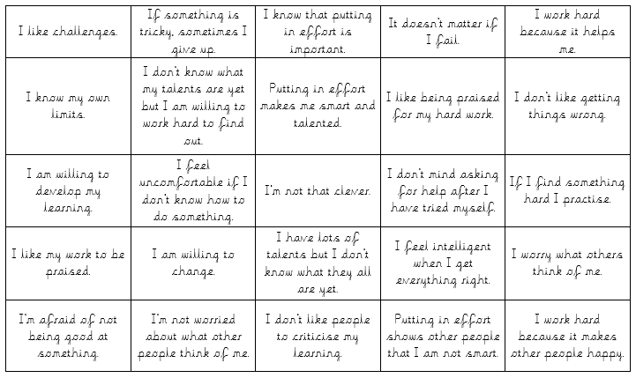

Slide 5
Mindset statements
KS1
KS2
Fixed Mindset | Growth Mindset
Avoid trying new things | Love trying new things
Ignore my teacher’s help | Use my teacher’s help
Hate help from my teacher | Love my teacher’s help
Hate making mistakes | Learn from mistakes
Don’t like it when others are better than me | Love my friends doing well and want to be like them.
I can’t get smarter | I can get smarter
Give up easily | Keep going
Trying hard is pointless | Trying hard is important
Trying hard shows you’re not smart | Trying hard makes you smart
Fixed Mindset | Growth Mindset
Avoid challenge | Love challenges
The world is fixed | The world can change
Ignore feedback | Use feedback
Hate criticism | Learn from criticism
Hate making mistakes | Learn from mistakes
Threatened by others success | Inspired by others success
Intelligence stays the same | Intelligence can develop
Give up easily | Keep going
Effort is pointless | Effort is important
See setbacks as failure | Learn from setbacks
Putting in effort shows you’re not smart | Putting in effort makes you smart
Achieve less. | Achieve more.

Slide 6
What is intelligence
Is there a definition of intelligence that everyone agrees with?
Are you born intelligent or can you develop it?
What does intelligence look like?
What does intelligence sound like?
Is everybody intelligent?
Can a test result show how intelligent an individual is?
Are there different kinds of intelligence?
Who do you know that is intelligent – why?
Were these people born intelligent?
What evidence do we have to suggest that these people are intelligent?
What have they achieved? How did they achieve it?

Slide 7
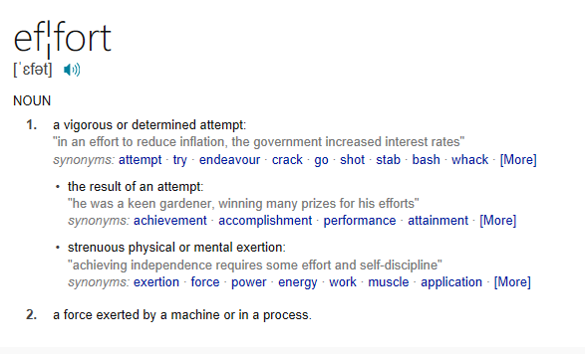
What is Effort

Slide 8

What is risk?
Take some risks and a BIG leap in your learning to make a splash in the SEA OF OPPORTUNITY

Slide 9
What is learning?
Comfort zone
Challenge zone
Breakthrough zone

Slide 10

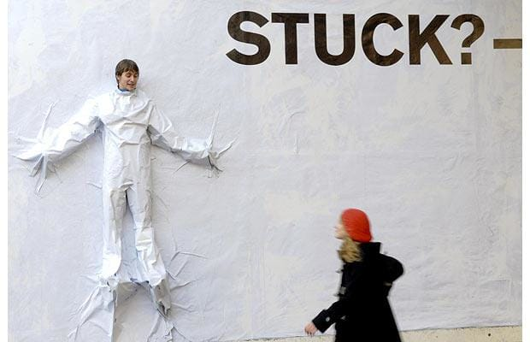
Being ‘stuck’

Slide 11
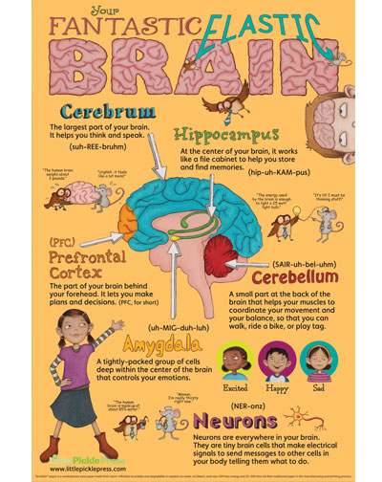
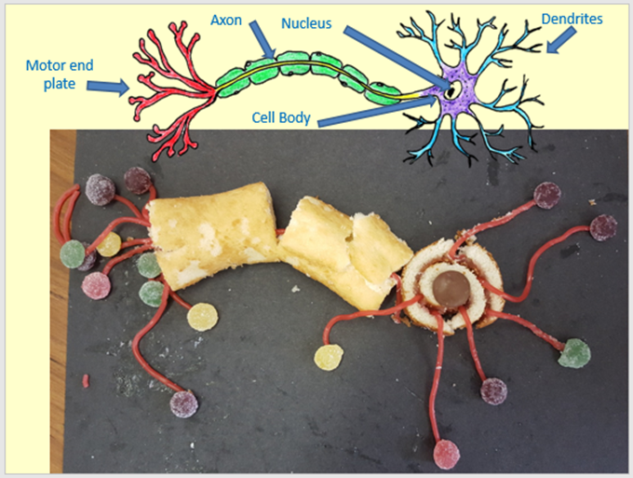
What is the Brain?

Slide 12
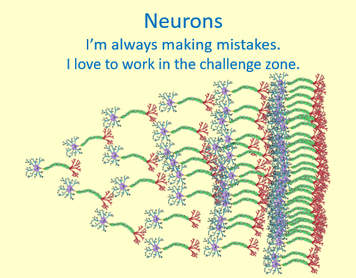
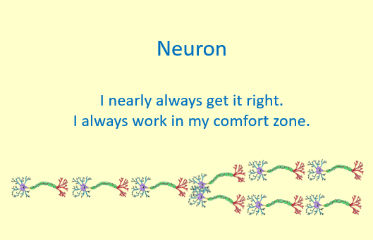

Making mistakes

Slide 13
Overview
Why is it okay to make mistakes?
The starting point.
Assessing where their mindset it.
the brain?
risk taking?
intelligence?
effort?
How do we learn?
Learning buttons
being stuck?
What is…
Starting to learn the different mindsets
Understanding them
Memorising
Displays!
Classroom incentives

Slide 14
What we did…
Half an hour session, once a week, with a big drive 1st week back in September. Covering sessions 1-3 in the planning guide
As it builds momentum, it must become everyday language.
Autumn term will be key, with refreshers at the start of each term.
Each year this will become easier as the children will have grown up with it, therefore the activities will need to evolve as the cohorts move through the school.
Therefore:
  Each class has a copy of the planning document.
  They annotate the document (in a set colour) as they do activities, adding new activities as they go.
  Document is kept on the shared area so that others can look and ‘magpie’ ideas.
  The planning document is a working document.

Slide 15
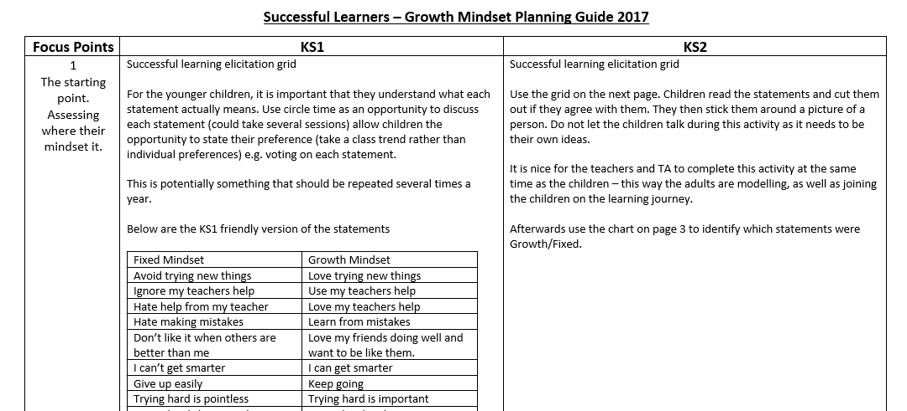
planning document

Slide 16
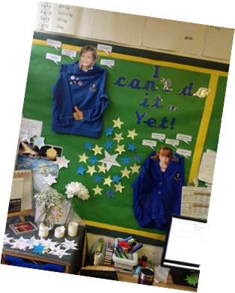
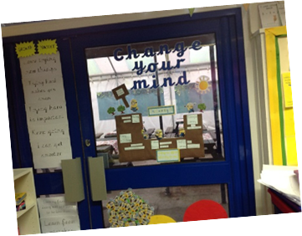
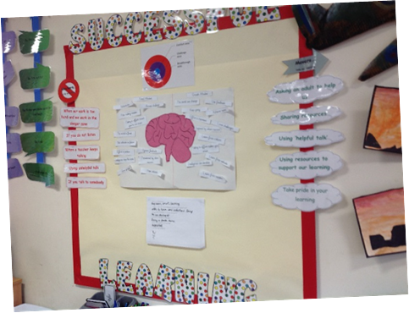
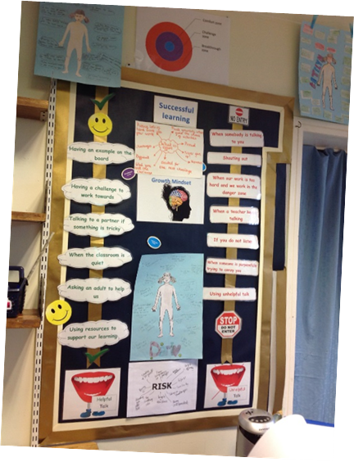
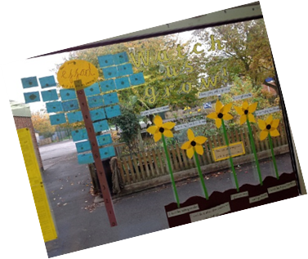
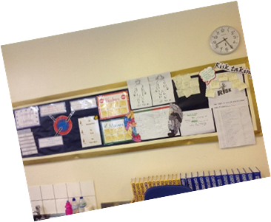
In the classrooms

Slide 17
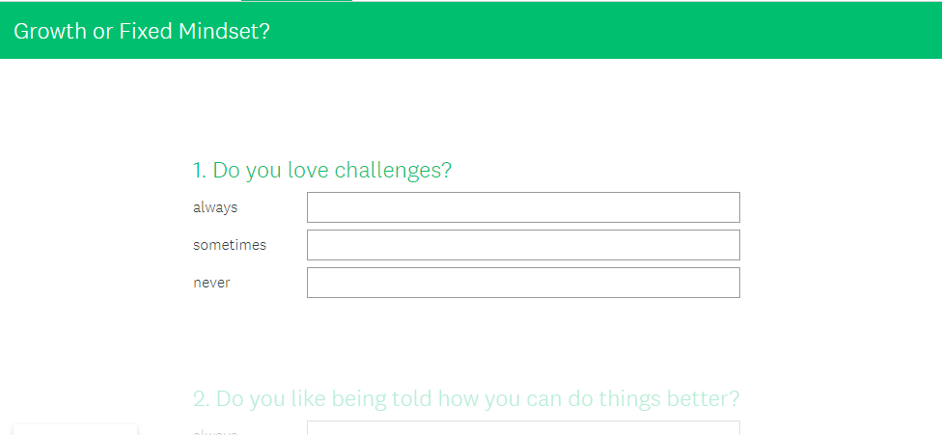
Measuring the impact

